Slide 1
New Hire
Benefits Presentation
9/1/2021

Slide 2

Table of Contents
1
Welcome
Eligibility and Enrollment
Medical Plans
Dental
Vision
Life Insurance
7
Disability
Flexible Spending Accounts
Commuter Benefits
Well-Being and Emotional Health
Retirement Savings
2
8
3
9
4
10
5
11
6

Slide 3
Welcome to Athletico!
Return to Table of Contents
The Benefits team would like to take this opportunity to say congratulations on your new position and welcome to the Athletico team! You are joining a group of over 5,000 dedicated team members across 12 states.
The following is important information regarding your benefits enrollment and the Athletico benefits package offered.

Slide 4

Eligibility & Enrollment
Elections must be completed within 30 days from benefits eligibility date
* Once the enrollment period ends you will only be able to elect or make changes during annual enrollment, unless you experience a qualifying life event
Employees will receive an email shortly after their first
day from ADP with online enrollment instructions
Dependent eligibility must be verified by ADP Dependent Verification Services (DVS)
Benefits begin for eligible new hires
on the date of hire.

Slide 5
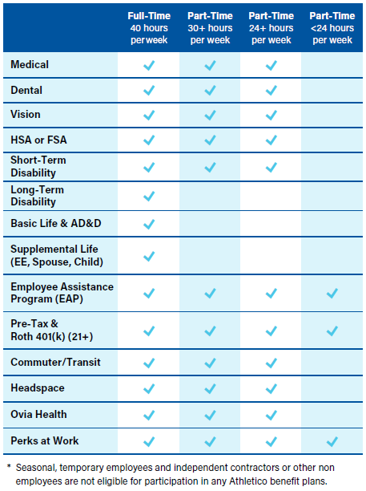
What am I eligible for?
Benefits begin for anyone consistently working 24 or more standard hours per week
All employees 21 years of age and over are eligible for the 401(k) plan regardless of hours worked or job title
There is a benefits price differential when working a minimum of 30 hours per week
PTO starts accruing when you work a minimum of 30 hours per week
Full-time employees (40+ hours) receive life and AD&D coverage along with long-term disability
IMPORTANT: If the hours you are working changes to where you become eligible for one or more benefits on a permanent basis, talk to your manager immediately about a status change.

Slide 6
Spousal/Domestic Partner Exclusion
Return to Table of Contents
IMPORTANT!
If your spouse/domestic partner becomes eligible for medical coverage through his/her employer at any time while on the Athletico medical plan, it is your responsibility to remove them from coverage within 31 days of their benefits effective date.
If your spouse/domestic partner has
access to medical coverage through
his/her employer, they will not be eligible
for Athletico’s medical coverage.
All other benefits are open to enroll
your spouse/domestic partner, such
as dental, vision, etc.

Slide 7


Medical
Plans

Slide 8

Comparing the Medical Plans
Benefit | HSA | PPO | Minimum PPO
Medical In-Network
Deductible Individual/Family | $2,500/$5,000 | $1,000/$2,000 | $5,000/$10,000
HSA Seed (match) | $500/$1,000 | N/A | N/A
Out-of-Pocket Maximum Individual/Family | $4,000/$8,000 | $3,250/$6,500 | $8,150/$16,300
Coinsurance | 80% | 80% | 80%
Office Visit PCP/Specialist | 80% after deductible | $30/$50 copay, No deductible | $40/$80 copay, No deductible
Inpatient/Outpatient Hospital | 80% after deductible | 80% after deductible | 80% after deductible
Emergency Room | 80% after deductible | $100 copay after deductible | $200 copay after deductible
Medical Out-of-Network
Deductible | $5,000/$10,000 | $2,000/$4,000 | Out-of-Network not covered
Coinsurance
Out-of-Pocket Maximum | $10,000/$20,000 | $6,000/$12,000
Pharmacy
Generic | $10/$20 after deductible | $10/$20, No deductible | $10/$20, No deductible
Preferred Brand | $50/$100 after deductible | $50/$100, No deductible | $50/$100, No deductible
Non-Preferred Brand | $75/$150 after deductible | $75/$150, No deductible | $75/$150, No deductible

Slide 9
Medical Plans Bi-weekly Contributions Non Tobacco
30-40 hours per week | HSA | PPO | Minimum PPO
Coverage Category
Employee Only | $26.82 | $72.41 | $8.04
Employee + Child(ren) | $94.29 | $254.58 | $28.29
Employee + Spouse | $106.90 | $288.63 | $32.07
Employee + Family | $134.09 | $362.03 | $40.23
24-29 hours per week | HSA | PPO | Minimum PPO
Coverage Category
Employee Only | $122.75 | $146.57 | $8.04
Employee + Child(ren) | $323.21 | $351.40 | $251.05
Employee + Spouse | $358.44 | $388.39 | $280.09
Employee + Family | $512.05 | $554.85 | $410.86
If your spouse or domestic partner works and has access to coverage through their employer, they are
not eligible as a dependent on Athletico’s medical plan and should not be added to medical coverage.

Slide 10
Medical Plans Bi-weekly Contributions Tobacco
30-40 hours per week | HSA | PPO | Minimum PPO
Coverage Category
Employee Only | $56.82 | $102.41 | $8.04
Employee + Child(ren) | $124.29 | $284.58 | $58.29
Employee + Spouse | $136.90 | $318.63 | $62.07
Employee + Family | $164.09 | $392.03 | $70.23
24-29 hours per week | HSA | PPO | Minimum PPO
Coverage Category
Employee Only | $152.75 | $176.57 | $8.04
Employee + Child(ren) | $353.21 | $381.40 | $281.05
Employee + Spouse | $388.44 | $418.39 | $310.09
Employee + Family | $542.05 | $584.85 | $440.86
If your spouse or domestic partner works and has access to coverage through their employer, they are
not eligible as a dependent on Athletico’s medical plan and should not be added to medical coverage.

Slide 11

Utilizing Your Health Savings Account (HSA)
Athletico will help you reach your goals for saving and paying for your health care. If you are enrolled in the HSA plan and make contributions to your HSA account:
  Athletico will match your contributions up to $500 per year if you have single coverage.
  Athletico will match up to $1,000 per year if you cover dependents.
  These contributions are made on a quarterly basis and are yours to keep, even if you leave Athletico.
Funded by you and Athletico, up to IRS limits:
  $3,600 for Employee Only coverage
  $7,200 for all other coverage categories
You use the money in your HSA to pay for current and/or future health care expenses.
Automated medical claims integration with BCBSIL on the Member Website

Slide 12
Your “Real” Deductible
Athletico’s matching contribution to your HSA reduces the amount you spend out-of-pocket before the plan begins paying coinsurance.
 | HSA Plan
 | Individual | Family
In-Network deductible | $2,500 | $5,000
Automatic HSA contribution match from Athletico | - $500 | - $1,000
Your “real” deductible | $2,000 | $4,000
The “real” deductible assumes that you receive the full Athletico employer contribution. Make sure to consider and take advantage of the full employer match when electing your HSA payroll contribution!

Slide 13
HSA Eligibility
Do I Qualify?
  To be eligible for the HSA, you cannot be enrolled in coverage under another non-qualified plan.
  If your spouse or domestic partner participates in a general purpose health care FSA that could reimburse you for medical expenses, you would not be eligible for an HSA.
  If you are enrolled in Medicare, you are not eligible to contribute or receive contributions from Athletico to an HSA.
    If you are age 65 and eligible to enroll in Medicare, but have not actually enrolled, you would be eligible to contribute to an HSA. It’s important to remember that in some cases, Medicare enrollment is automatic.
  If you are unclear on whether or not you qualify, you should refer to the resources below.
    IRS Publication 969
    Your local Social Security office

Slide 14

Advantages of HSAs
Triple Tax Savings
You contribute on a pre-tax basis through payroll deductions (this lowers your overall income, which lowers your overall tax bill)
Money grows tax-free with interest
Money withdrawn is also tax-free when used to pay for health care expenses
Flexibility
You decide how much to contribute – and you can increase, decrease or stop contributions at any time
You decide how to use it
  Save it: Pay out of pocket for current expenses and build up your HSA balance
  Spend it: Use your HSA to pay for health care expenses you incur today
  Both: Use your HSA to pay for some expenses and save the rest
The money is yours to keep
Balance rolls over from year to year – you don’t lose it
You take your HSA balance with you if you leave or retire from Athletico (both your and the company’s contributions)

Slide 15
Which Plan Is Right for You?
For assistance with understanding your plan options you can contact our new Member Advocacy team via phone at 800.563.9929, Monday through Friday, 8:30 am to 5 pm (EST), or via the web at: www.connerstrong.com/memberadvocacy
  Do the math:
  Don’t focus only on the deductible or annual out-of-pocket maximum amounts
  Add up your contribution amounts for each plan
  Consider costs you’ll incur for non-preventive doctor visits and prescription drugs
  Think about your anticipated health care needs for next year:
  If you are generally healthy and expect to use a low to average amount of health care next year, the Minimum PPO plan may be right for you
  If you expect to use a significant amount of health care next year (such as surgery or hospitalization), the PPO plan could be right for you

Slide 16
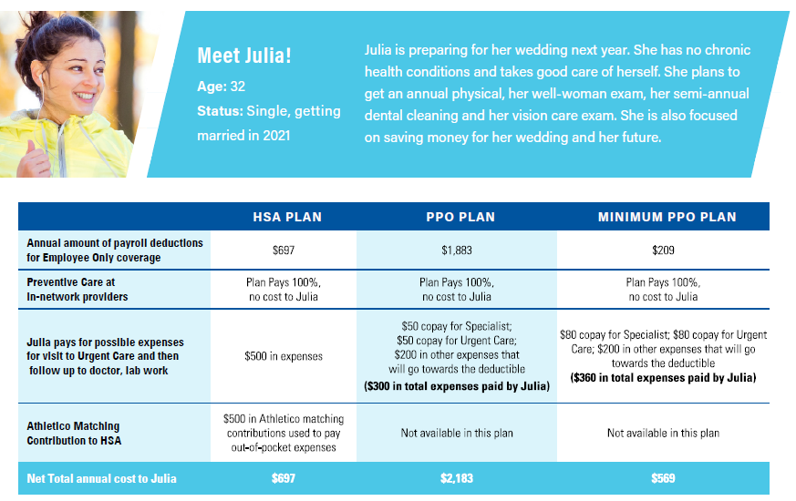
Member Examples

Slide 17
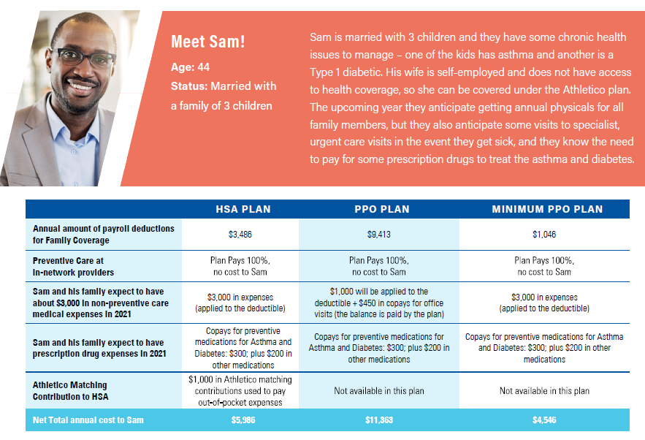
Member Examples
Return to Table of Contents

Slide 18

Dental
Benefits

Slide 19

Dental
100% coverage for preventive services, such as cleanings and oral exams
Basic services, such as fillings and extractions, covered at 80%
Major services, such as crowns, bridges and dentures, covered at 50%
Includes orthodontia for you, your spouse and your children up to age 19, covered at 50%
$2,000 annual maximum benefit per person
$2,000 lifetime maximum orthodontia benefit for dependent children to age 19 and adults
Bi-weekly Contributions Full-Time | Dental
Coverage Category
Employee Only | $7.24
Employee + Child(ren) | $16.92
Employee + Spouse | $13.82
Employee + Family | $28.26
Bi-weekly Contributions Part-Time | Dental
Coverage Category
Employee Only | $10.13
Employee + Child(ren) | $23.70
Employee + Spouse | $19.34
Employee + Family | $39.55

Slide 20
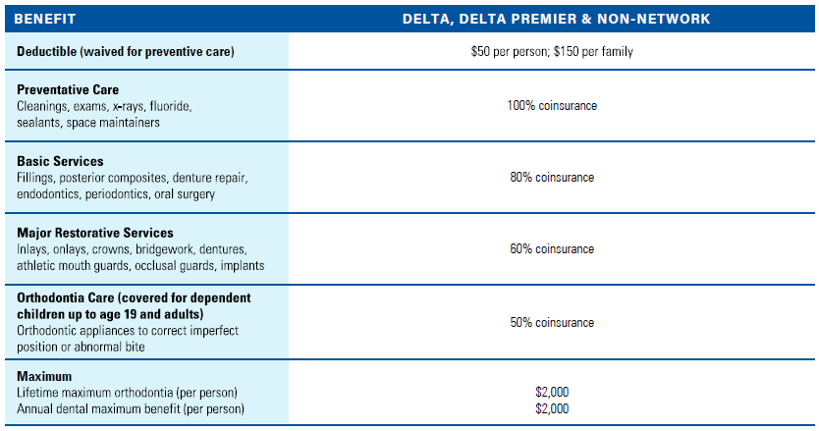
Dental

Slide 21
Dental
Return to Table of Contents
Enhanced Benefits Program
This program enhances coverage for individuals with specific conditions that can be positively affected by additional oral health
Additional cleanings and applications of fluoride will be provided for these individuals
Specific conditions include diabetes, kidney failure (dialysis), high-risk cardiac conditions, periodontal disease, suppressed immune systems, cancer related chemotherapy and/or radiation, pregnancy
How to Enroll
You must enroll in the program to receive additional benefits
Go to Delta Dental of Illinois member website at www.deltadentalil.com
Sign into Member Connection
Select “Enhanced Benefits” tab
Enter or update the small amount of health information required to qualify for extra benefits for yourself or your dependents

Slide 22

Vision Benefits

Slide 23


Vision
Comprehensive vision coverage through a network of preferred providers
Annual eye exams with $0 copay; contact lens fitting and evaluation with $40 copay
Includes coverage for eyeglasses or contact lenses on an annual basis
Eyeglass frames and contact lens allowance to up to $180
The vision plan also includes Freedom Pass, which allows members to get any frame at any cost with no out of pocket cost at either Target or LensCrafters.
Bi-weekly Contributions | Vision
Coverage Category
Employee Only | $4.74
Employee + Child(ren) | $11.86
Employee + Spouse | $9.72
Employee + Family | $14.00

Slide 24
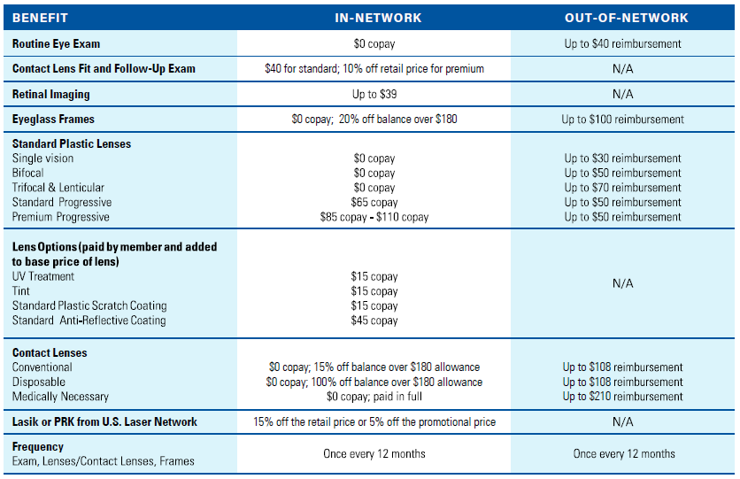
Vision
Return to Table of Contents

Slide 25

Life Insurance

Slide 26

Life and AD&D
Return to Table of Contents
Life and AD&D benefits protect your family in the event of your death
while you are actively employed at Athletico
Basic life insurance coverage:
  2 x salary to $500,000 maximum
Employee supplemental life insurance:
  $10,000 increments up to the lesser of 5 times your annual salary or $500,000
Spousal/domestic partner supplemental life insurance:
  $5,000 increments up to the lesser of the employee’s salary or $100,000
Child supplemental life insurance:
  $10,000 flat
Reminder!
Don’t forget to designate your primary and secondary (if applicable) beneficiaries.

Slide 27

Disability Insurance

Slide 28
Disability Insurance
If you become ill or injured (non-work related), these benefits ensure income protection for both brief absences and long periods of disability
Short-term disability: available to all employees working 24+ hours per week and has been increased to 6 months (26 weeks)
Long-term disability: available to all full-time employees working 40 hours per week
Both short- term and long-term disability are a 100% Athletico paid benefit provided by Voya
Buy-up Long-term disability*: to add more protection, you can purchase a supplemental policy that will increase your company paid long-term disability benefit amount. This option is 100% employee paid, and the benefit is subject to approval of evidence of insurability.
* This coverage requires evidence of insurability (EOI) before the coverage will take effect. You must complete the EOI form in myADP within 4 weeks of electing coverage. Voya's underwriting team will review your completed form to determine if your coverage will be approved. If approved, you will start to see premium deductions within the next 2-3 pay periods.

Slide 29
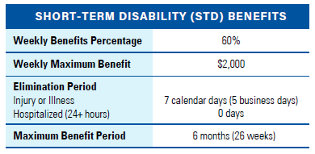
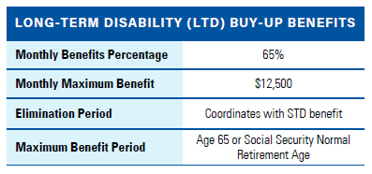
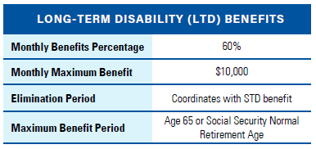
Disability Insurance
Return to Table of Contents
100% Athletico paid
100% Employee paid
*Disability benefits will be paid upon medical approval

Slide 30

Flexible Spending Accounts

Slide 31
Flexible Spending Accounts (FSA)
Athletico offers Health Care (FSAs) and Dependent Care (DCFSAs)
During the year, you can use your account to cover eligible out-of-pocket health care and dependent care expenses.
  Each account is separate; you cannot transfer funds from one to another.
  Enrollment is voluntary and you may choose to enroll in the plans that meet your needs.
IRS rules allow you to contribute to your account(s) an amount of your choice through payroll deduction on a pre-tax basis – before federal income tax, social security, and (in some cases) state and local withholding taxes are deducted – reducing your taxable income and increasing your take home pay.

Slide 32
Health Care FSA
A Healthcare FSA can help you pay out of pocket expenses such as deductibles, copays, prescriptions, dental services, orthodontics, eye exams, glasses, or contacts.
Full details regarding eligible healthcare expenses are available in IRS Publication 502, which is on the IRS website at www.irs.gov/publications/p502/index.html.
The maximum annual contribution to your Health Care FSA is $2,750. This amount is available to you up front at the beginning of the year.
Did you know?
Athletico allows employees to carry over $550 in unused Health Care FSA contributions from year to year. You can submit claims until March 31, 2022 for claims occurring between 1/1/2021 to 12/31/2021. After that, any unused dollars over $550 will be forfeited so don’t let your cash go to waste!

Slide 33
Healthcare FSA vs. HSA
Benefit | HSA | FSA
Eligibility | Only for those enrolled in the HSA medical plan option | Any employee who does not have an HSA account; not tied to medical plan election
Employer match funding | $500/$1,000 | N/A
Funds availability | Available balance based on contributions to date | Entire annual election is available up front
Eligible expenses | Determined by the IRS www.irs.gov/publications/p502 | Determined by the IRS www.irs.gov/publications/p502
Tax Advantages | Triple Tax Advantage: contributions, growth, eligible distributions | Contributions are pre-tax
Portability | Account stays with you, even if you leave Athletico | Employer owned account; available only while at Athletico
IRS contribution limit | $3,600/$7,200 | $2,750
Catch up contributions over age 55 | $1,000 | N/A
Rollover | Entire balance rolls over from year to year | $550 of unused funds can be rolled over to the next plan year
Claims integration through HSA Bank | Automatically enrolled | Automatically enrolled

Slide 34
Utilizing Your Healthcare Flexible Spending Account (HSA and FSA)
Automatic Claims Integration to your HSA and/or FSA Account
  Blue Cross Blue Shield of Illinois will send your claims report to HSA Bank so that your medical claims will appear in the HSA Bank Member Website for easy payment
  Eliminates the need to upload documentation for FSA reimbursement
  Allows you to pay medical claims directly through the HSA Bank mobile app or Member Website using HSA and/or FSA funds
Below are tips for managing your claims:
  Sign up for email and text notifications on your preferences page of the Member Website.
  It is not necessary for you to use your debit card at a medical provider when you have linked healthcare claims, unless it is a copay or prescription that requires payment at the time of service. The claim will be automatically sent to HSA Bank from BCBSIL and you can pay it on the Member Website
You will be automatically enrolled in this service. If you do not wish to participate, visit the Member Website to opt out.

Slide 35

Dependent Care FSA
Return to Table of Contents
If you have child care expenses in the form of day care, pre and post school programs, or summer day camp for eligible dependents age 13 and under, a Dependent Care FSA may be for you.
Individuals may contribute up to $10,500 pre-tax annually to their account. Detailed information about eligible expenses can be found on the IRS website at www.irs.gov/publications/p503/index.
Expenses not related to day care are not eligible for reimbursement.
  Educational expenses
  Overnight camps
  Nursing home care
  Meals
  Special classes (e.g. dance or swimming)

Slide 36

Commuter Benefits

Slide 37
Return to Table of Contents
Commuter Benefits
You have the opportunity to enroll in a spending account specific to work-related transit expenses, such as parking passes and tokens for buses, trains, and ferries.
Transit pre-tax reimbursement accounts allow you to pay for eligible work-related transit commuter expenses through pre-tax payroll deductions from your paycheck.
You can contribute up to $270 a month, pre-tax, for each account. That’s $540 total!
If your costs exceed this limit, you can add up to $230 a month, post-tax, for each account.
Carry over your funds! Any unused funds from your transit account may be carried over to subsequent years, while you are an active Athletico employee.
Remember!
Transit funds can only be accessed by using the HSA Bank debit card. Parking expenses are reimbursement only.
If you wish to stop or suspend your commuter benefits at any time, consider dropping to a $5 contribution rather than waiving to avoid forfeiting your balance.

Slide 38
Well-Being and Emotional Health

Slide 39

Well-Being and Emotional Health
Health and well-being is essential to our culture at Athletico.
We have created a suite of resources to help you and your family members focus on maintaining healthy lives.

Slide 40
Well-Being and Emotional Health
Resource | Description | Website
Well onTarget | Tools to help you set and reach your wellness goals. Earn Blue Points for making healthy choices, enrolling in the Fitness Program or taking your Health Assessment. You can also earn points when you achieve milestones in the Self-Management Programs. Redeem your Blue Points in the online shopping mall, which offers a wide variety of merchandise. | wellontarget.com
Healthy Learn | Covers over a thousand health and wellness topics including smoking cessation, stress management, symptom checker, and so much more | healthylearn.com/connerstrong
Ovia Health | Mobile apps provide personalized, daily support for your fertility, pregnancy, and parenting journey. Available to all regular full-time and part-time employees working 24 or more standard hours per week, at no cost to the employee. | Download the Ovia Mobile App (additional instructions in eGuide)
Headspace | On-demand solution that helps you take a preventive approach to managing your emotional health. Free access to benefit eligible employees from October 1, 2020 to September 30, 2021 | work.headspace.com/athletico/ member-enroll.

Slide 41




Family Planning – Ovia Health
Ovia offers easy access to resources and support services to assist with family planning, maternity and parenting. It helps families be able to provide nurturing care during early childhood and beyond through a high-tech platform that is respectful of our employees’ privacy.
Mobile apps provide personalized, daily support for your fertility, pregnancy, and parenting journey.
Available to all regular full-time and part-time employees working 24 or more standard hours per week, at no cost to the employee.
Getting Started is Easy!
Download the app that’s right for you: Select “I have Ovia Health as a benefit” during setup
Enter Athletico as your employer
Employees enrolled in Athletico medical coverage through BCBS: You must select BCBSIL as your health plan and Athletico as your employer
Already have an Ovia app on your phone?
Open your app and tap “Health” on the bottom navigation bar to take the Ovia Health Assessment
Tap the “Update my healthcare information” box and enter Athletico as your employer

Slide 42

Employee Assistance Program
Confidential service available to you and your household members at no cost, 24/7
In person, phone or online sessions
Common issues:
  Mental health and well being
  Personal and professional relationships/conflicts
  Substance abuse
  Grief and loss
  Stress, anxiety and depression
Contact GuidanceResources any time toll-free at 877.533.2363 or visit www.guidanceresoucres.com (Web ID: MY5848i)

Slide 43
Headspace
Headspace for Work is an on-demand solution available to benefit eligible employees that offers access to tools to support emotional health and well-being
  Mobile app offers hundreds of sleep exercises and meditations
  Offline content when downloaded to a mobile device
  Mindfulness courses to suit your mood and lifestyle
  Access is free through September 30th, 2021
Getting Started
You may create an account or log into an existing Headspace account directly via web at work.headspace.com/athletico/member-enroll.
You must enroll using the enrollment link. After you have created an account you may download the mobile app in the Apple App Store or Google Play (Search for Headspace: Meditation and Sleep).

Slide 44

Perks at Work
Return to Table of Contents
Exclusive employee discount platform with offers on:
  Travel: flights, hotels, car rentals
  Health & Fitness
  Electronics
  Tickets
  Home & Garden
  Restaurants
  Flowers & Gifts
  Financial Wellbeing
How to Register
  Go to www.perksatwork.com and click “Register for Free”
  Enter your work email address, and type Athletico in the Company Name box
  Select “Create My Account” and start saving!

Slide 45
Retirement
Savings

Slide 46

401(k) Retirement Plan
All employees age 21 and over, regardless of job title or hours worked, are eligible to participate in the 401(k)
All newly eligible are auto-enrolled at 5% (pre-tax) of your eligible compensation unless you choose to opt-out or change your contribution amount
You can make changes to your contribution amount at any time by going to Benefits OnLine at rps.troweprice.com, or calling T. Rowe Price at 800.922.99455
Your contribution options are as follows up to the 2021 IRS limit of $19,500:
  Pre-Tax
  Roth
  Catch-Up – Up to an additional $6,500 in contributions if age 50 or older
  After-Tax - after-tax dollars up to 5% of compensation, but taxes are deferred on any earnings and taxes on earnings are due upon withdrawal

Slide 47

401(k) Employer Match
Eligibility for the match includes:
  Working a minimum of 1,000 hours during the plan year
  Were either active or on leave of absence as of the last day of the plan year – December 31st
Athletico’s match is annual and discretionary
  Athletico may match up to 40% of the first 5% of your eligible pay you contribute
You will not see the match on each paycheck, but one full deposit into your 401(k) account typically in April of the following plan year

Slide 48

401(k) – Vesting
Return to Table of Contents
Vesting is your right to all or a portion of your account balance
Match money is subject to a 6 year vesting schedule – 20% each year starting at year 2
Athletico contributions to the Plan, adjusted for earning or losses, vest as follows:
Years of Service | Percent Vested
1 year | 0%
2 years | 20%
3 years | 40%
4 years | 60%
5 years | 80%
6 years | 100%

Slide 49
THANK YOU!
Return to Table of Contents
If you have additional questions, contact
Member Advocacy Team at 800.563.9929, Monday through Friday, 8:30 am to 5 pm (EST), or via the web at: www.connerstrong.com/memberadvocacy
Or the Athletico Benefits Department at
benefits@athletico.com

